Slide 1


SOFTWARE AND DESIGN ANALYSIS FINAL PROJECT’24
Productify

Slide 2
INTRODUCTION
Purpose: Its primary purpose is to allow users to compare products, check availability, analyze reviews, and explore second-hand products across platforms, all within a single interface.
The system will cater to a wide audience of online shoppers looking for convenience, efficiency, and better decision-making tools..

Slide 3
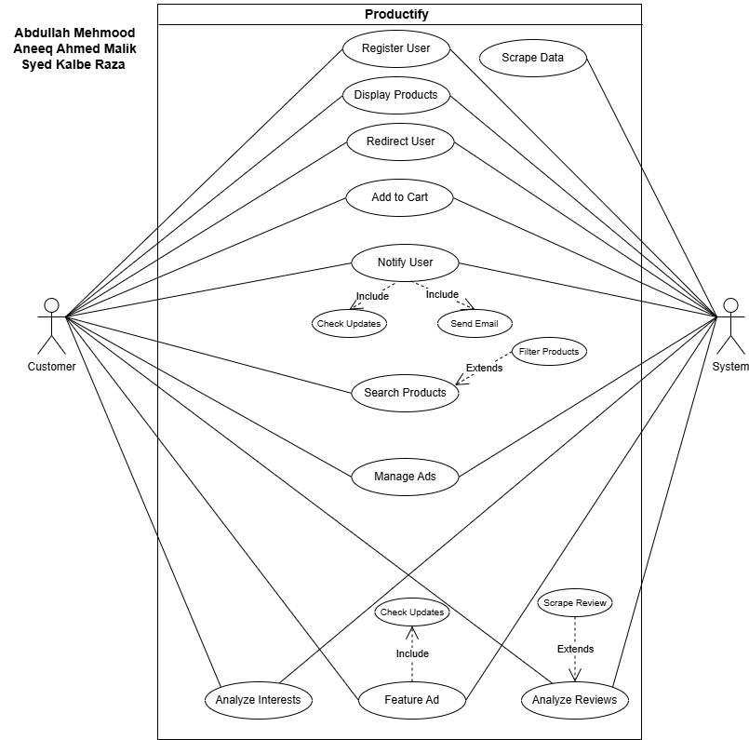

USE CASE DIAGRAM

Slide 4


NON-FUNCTIONAL REQUIREMENTS
Performance Requirements
•The system must respond to user actions (e.g., adding to cart, navigating, or searching) within
•The system must respond to user actions (e.g., adding to cart, navigating, or searching) within
Safety Requirements
•Prevent unintended data deletion by requiring confirmations before any permanent action (e.g., deleting ads).
BusinessRules
•Data Protection: Encrypt user data in transit (HTTPS) and at rest
•Regular security audits will be conducted to identify vulnerabilities

Slide 5
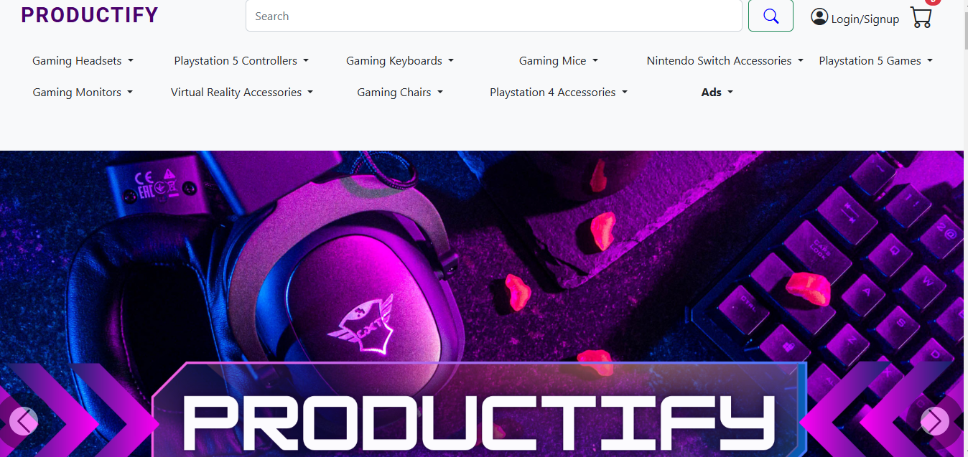
USER INTERFACES - DEMO

Slide 6
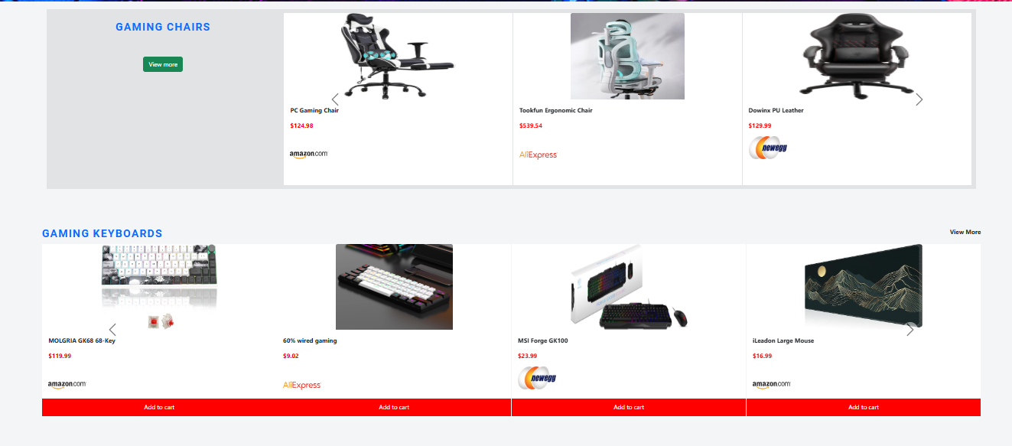
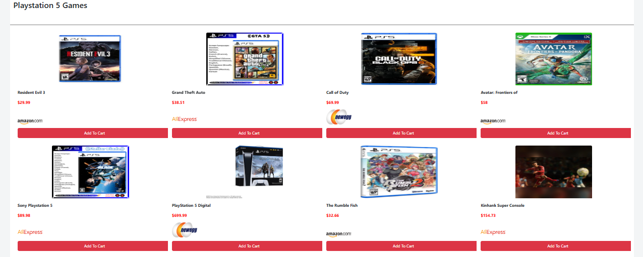
USER INTERFACES - DEMO

Slide 7
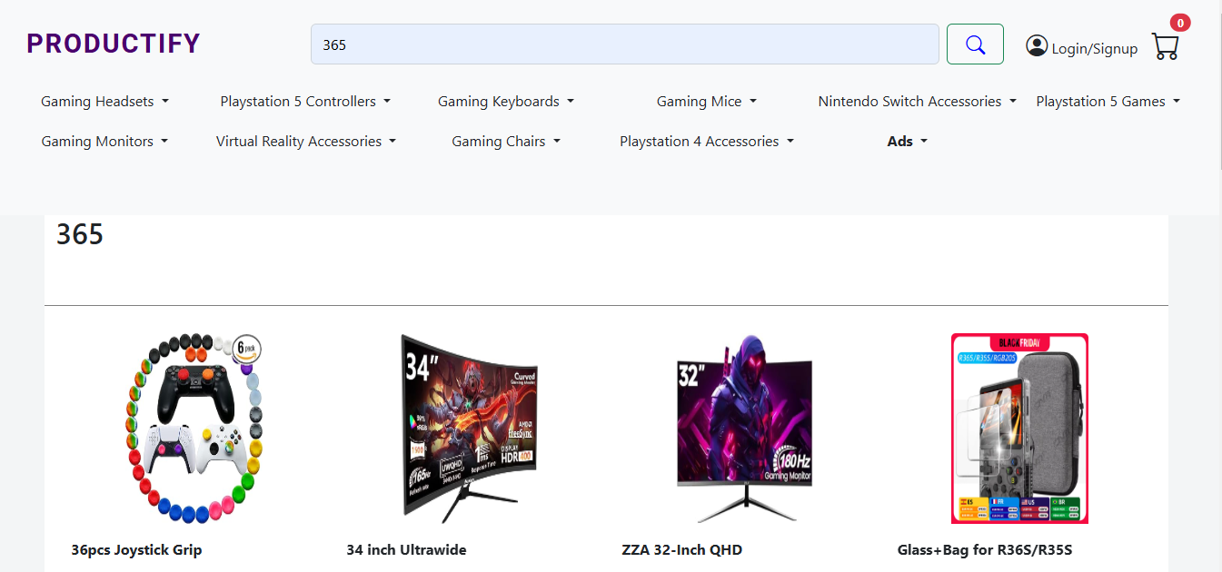
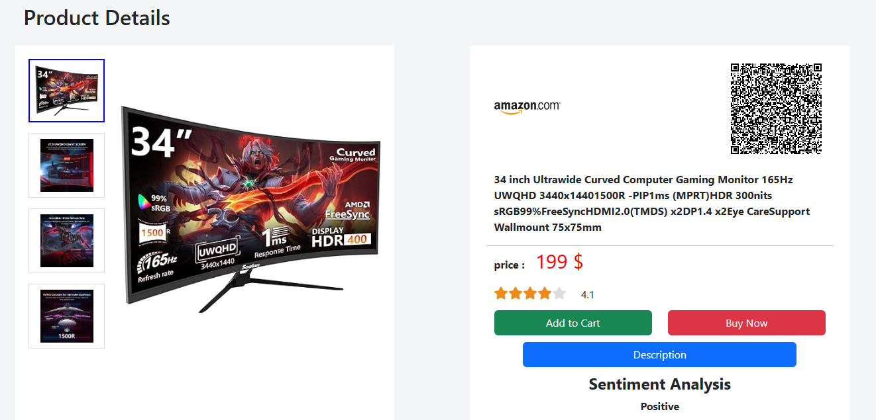
USER INTERFACES - DEMO

Slide 8
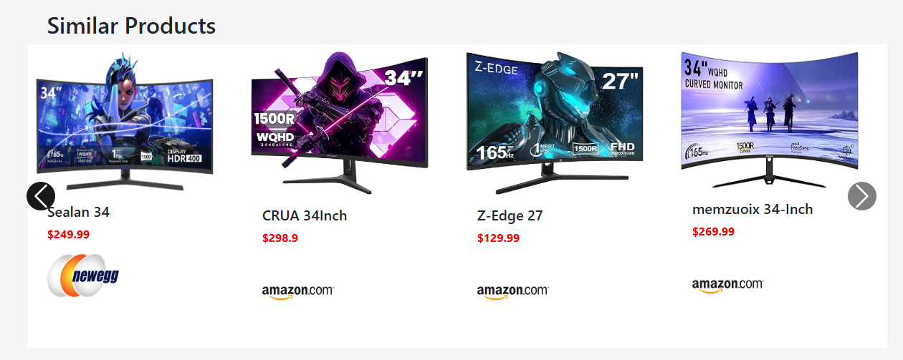
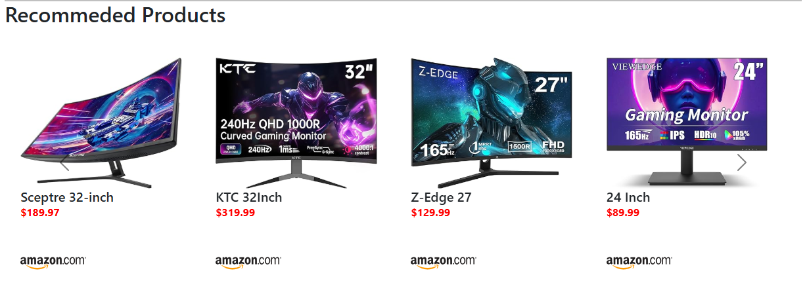
USER INTERFACES - DEMO

Slide 9
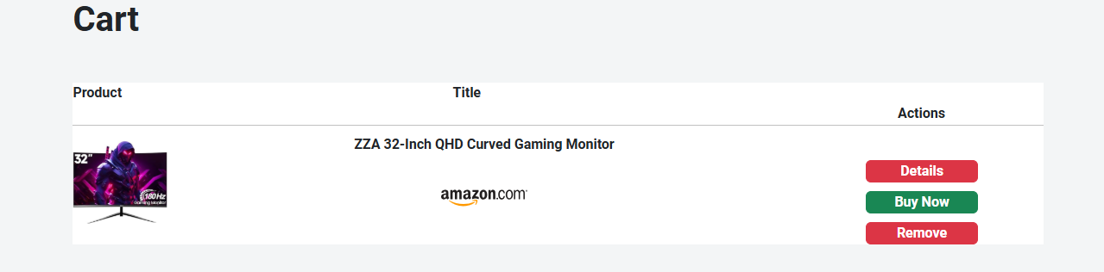
USER INTERFACES - DEMO

Slide 10
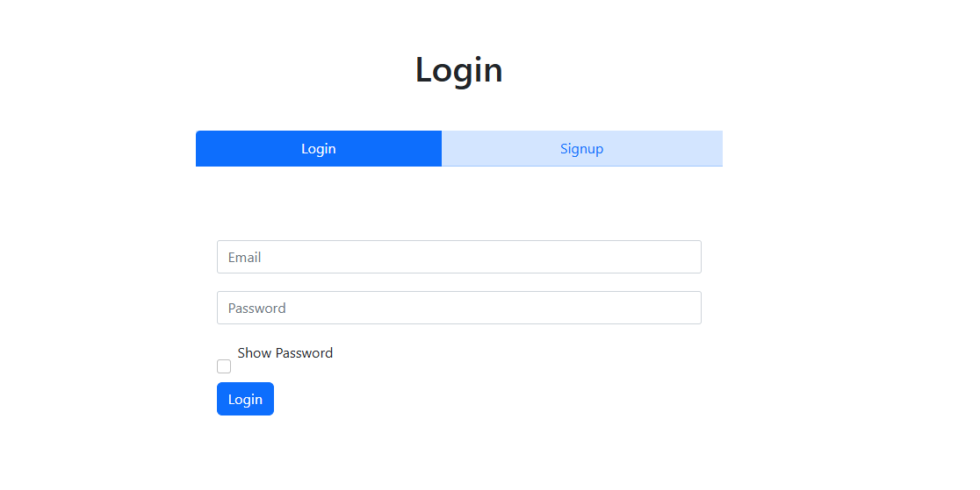
USER INTERFACES - DEMO

Slide 11
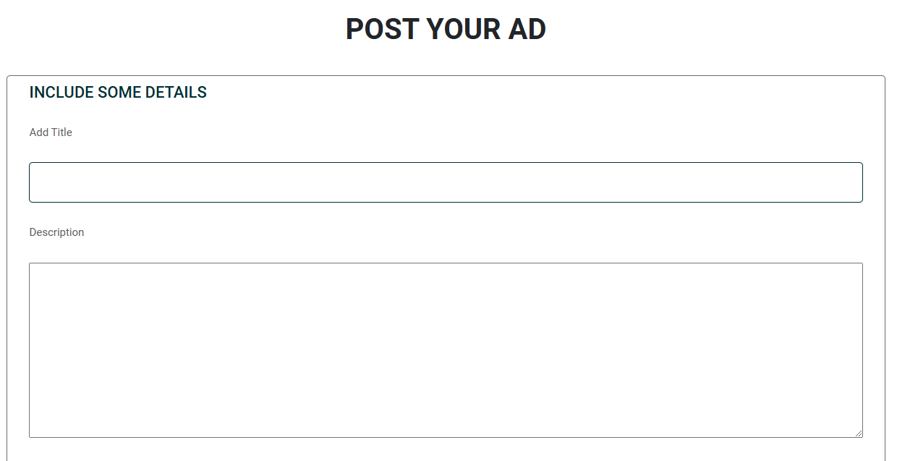
USER INTERFACES - DEMO

Slide 12
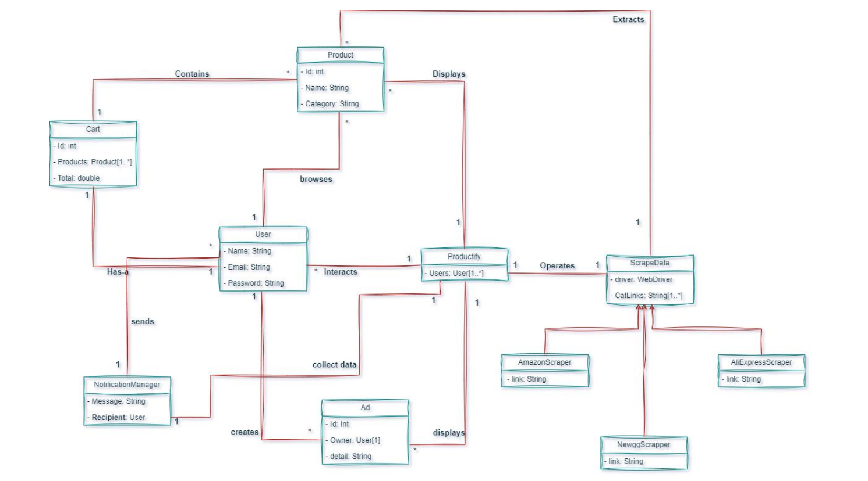
DOMAIN MODEL

Slide 13
SYSTEM SEQUENCE DIAGRAMS

Slide 14
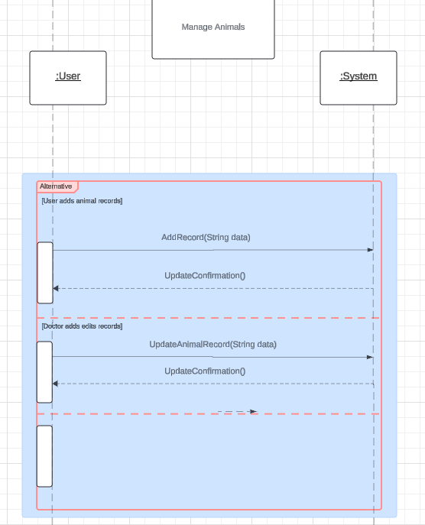
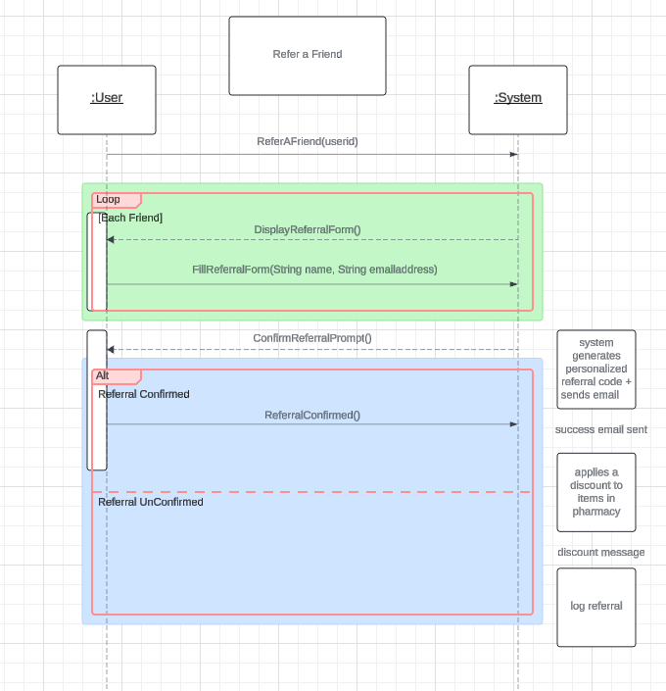

Slide 15
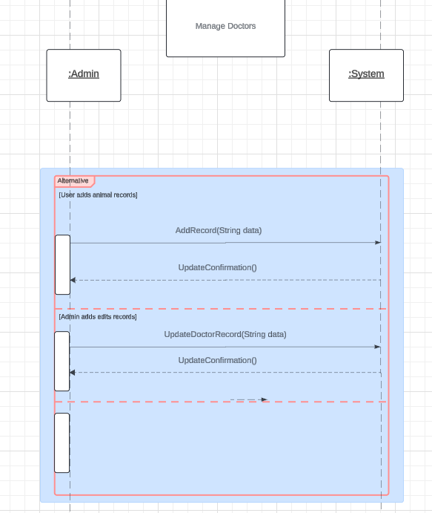

Slide 16
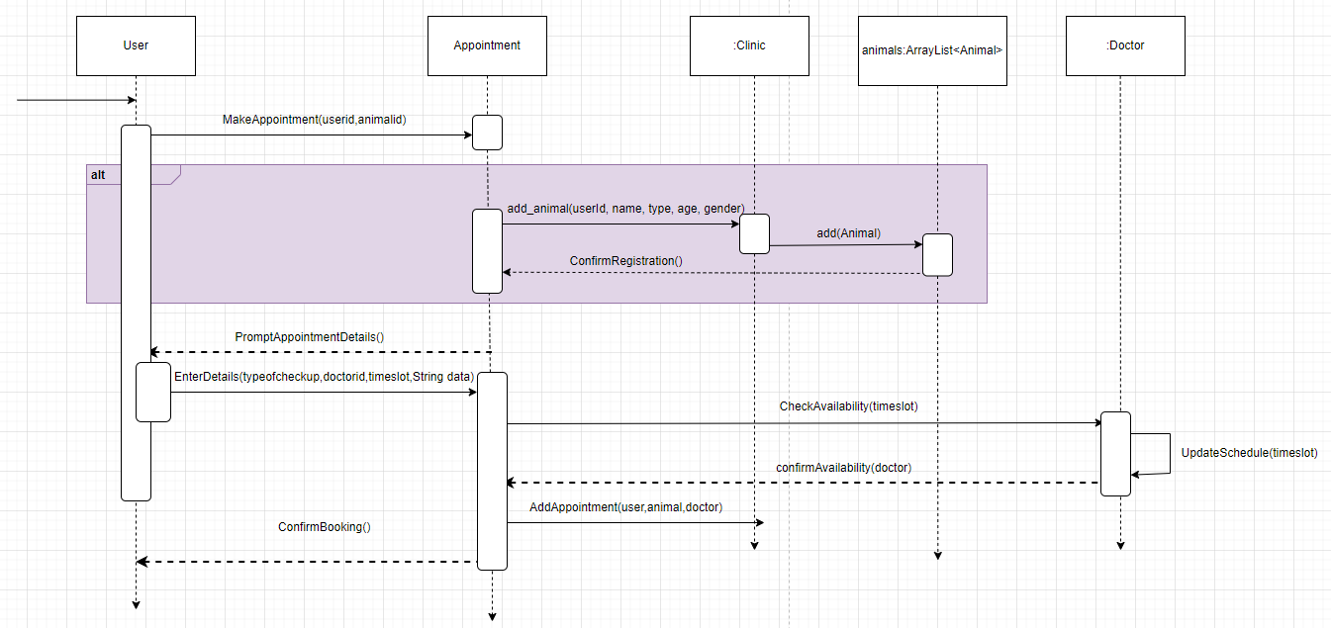
SEQUENCE DIAGRAM

Slide 17
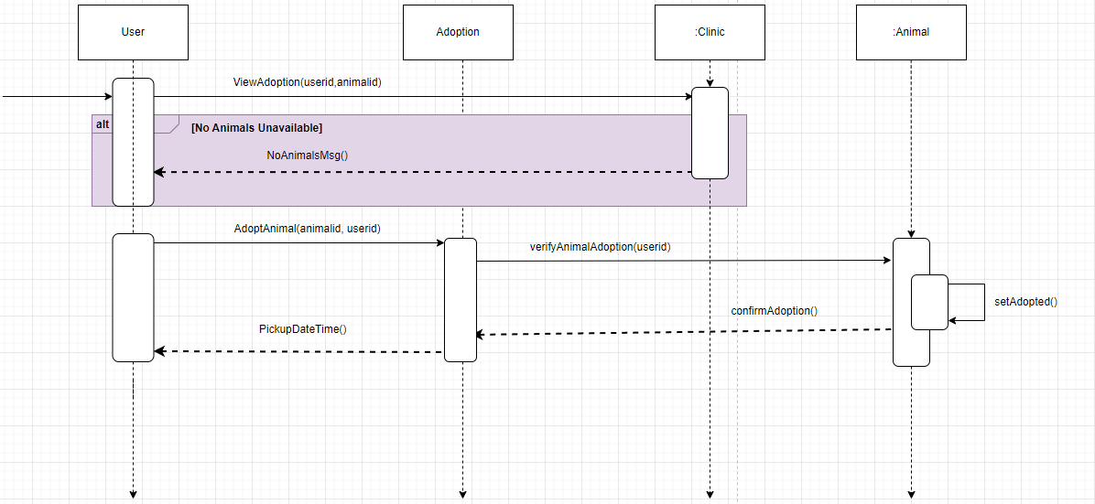

Slide 18
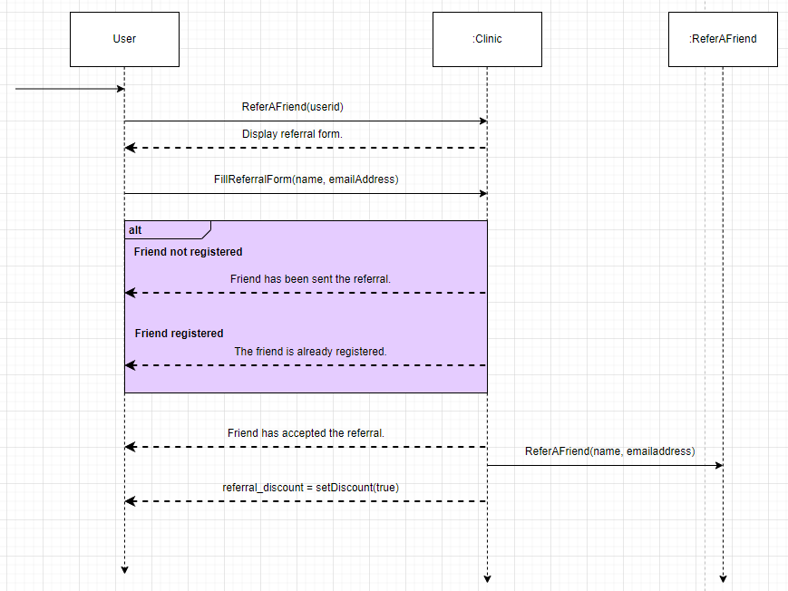

Slide 19
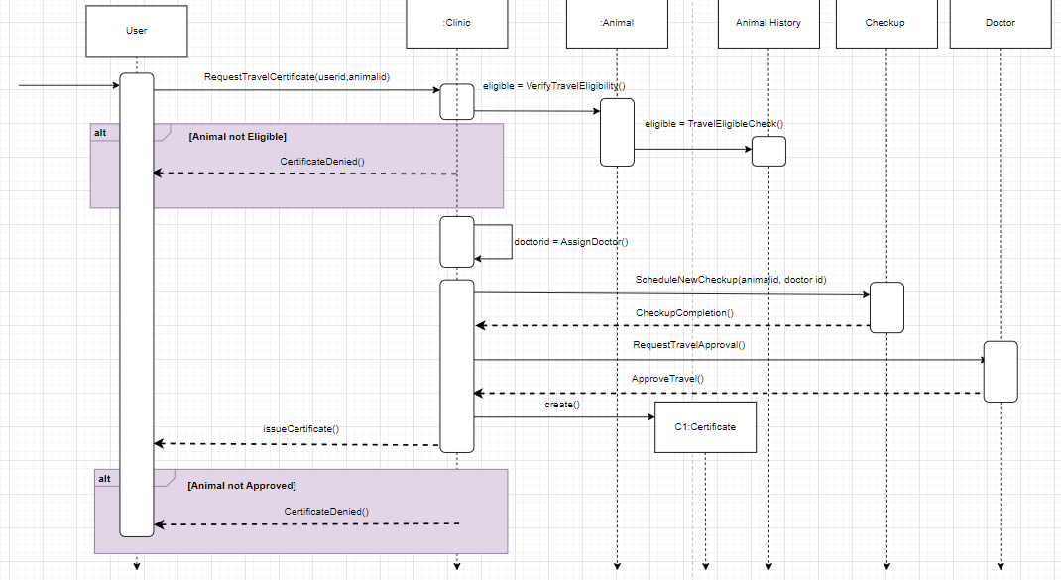

Slide 20
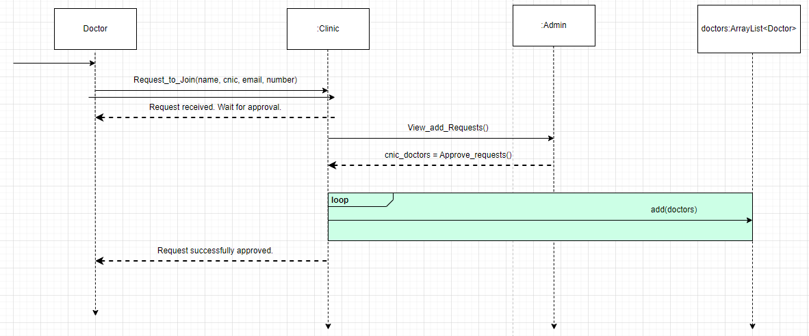

Slide 21
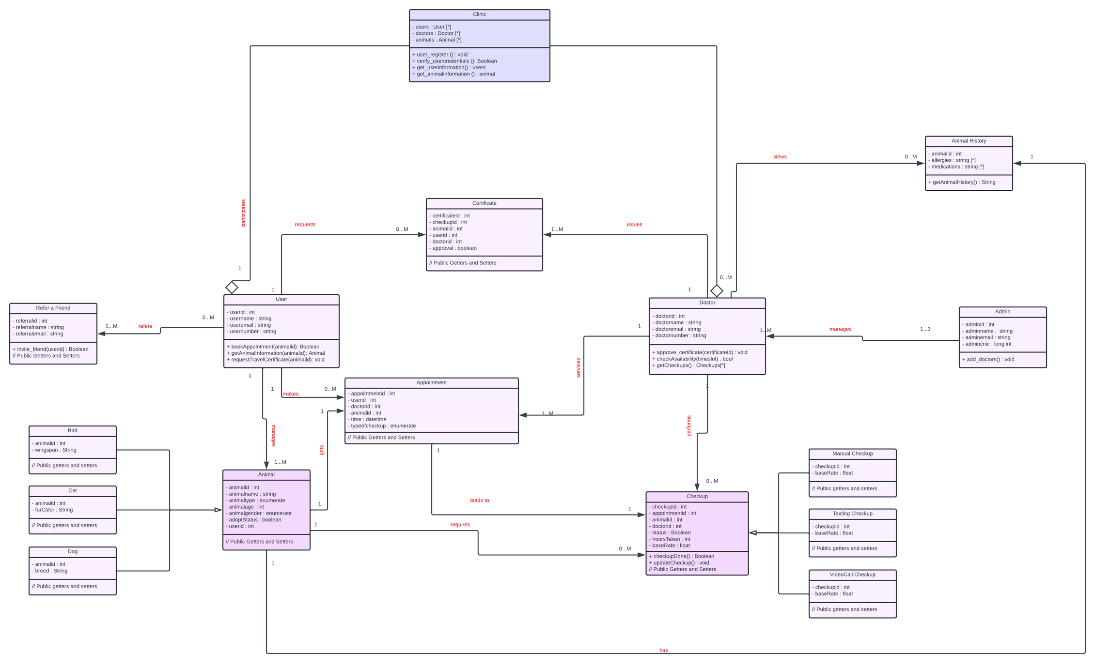
CLASS DIAGRAM

Slide 22
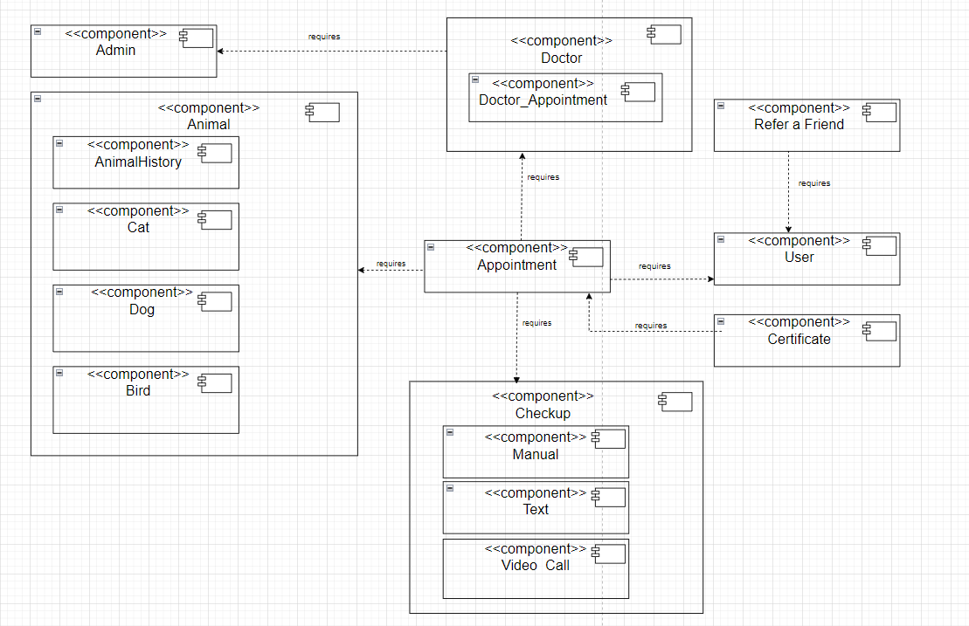
COMPONENT DIAGRAM

Slide 23
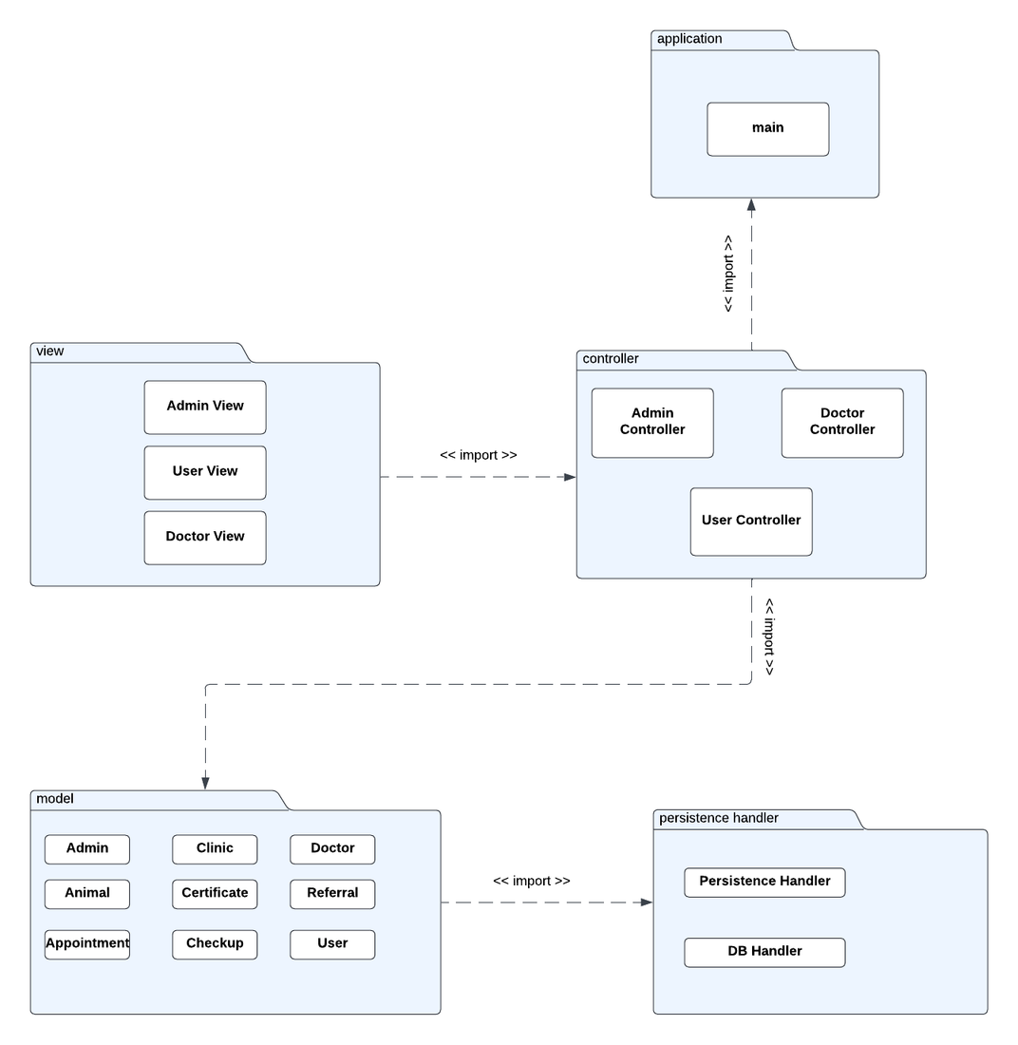
PACKAGE DIAGRAM

Slide 24
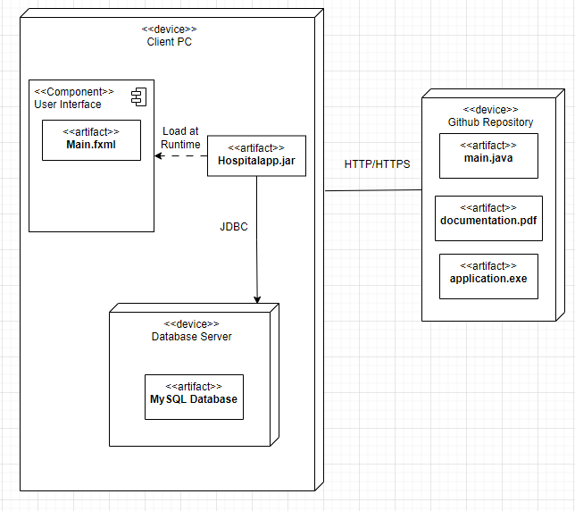
DEPLOYMENT DIAGRAM

Slide 25

DESIGN PATTERNS USED
GRASP PATTERNS USED:
Session Controllers (Corresponding to each Use Case)
Creator (User + Clinic)
Information Expert (Clinic + Animal History)
Low Coupling (animal_user + doctor_appointments + referAFriend)
High Cohesion - applied
GOF PATTERNS USED:
Singleton (Admin, User, SQL Handler)
Factory (Animal creation)
Strategy (CheckUp Types)
Observer (Travel Certificate Approval)

